Slide 1
GreyHat CTF Meeting #1!
9/19/2015
Siddarth Senthilkumar

Slide 2
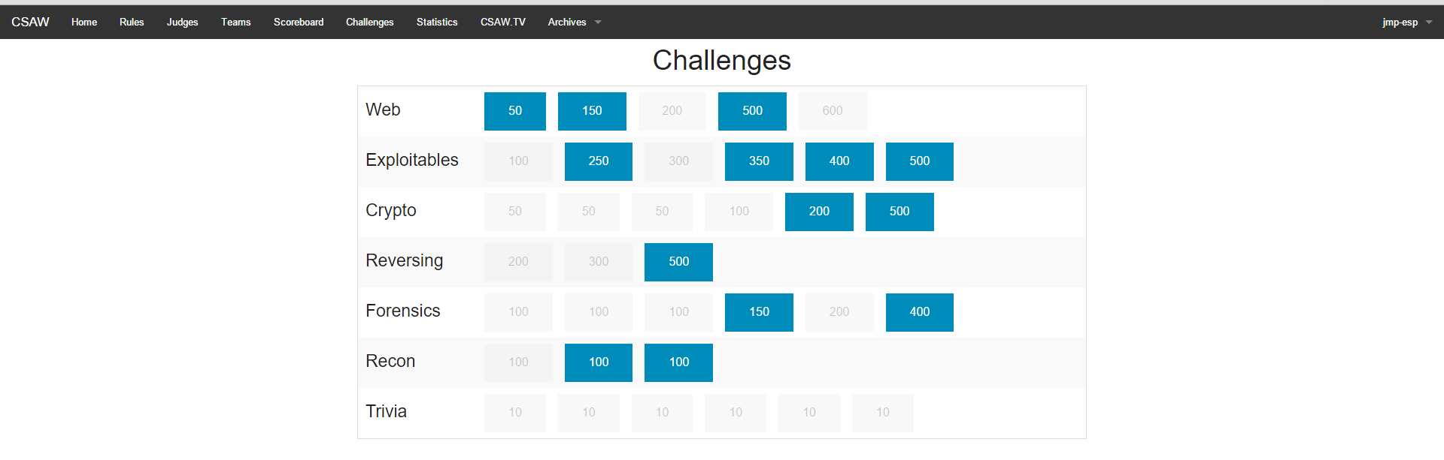
What are CTF’s?
“Capture the Flag”
Different types of CTFs
Jeopardy Style
Wargames
Red Team/Blue Team
Different types of problems to solve
Jeopardy:
Find a password, enter it on a website.

Slide 3
INTRO: Categories of Problems
Web Exploitation – Insecure sessions, code injection, make web-apps do things they’re not supposed to do, get access to places you’re not supposed to, etc.
Exploits – Find bugs in programs, use them to make the programs do things they’re not supposed to do.
Forensics – Find the hidden piece of information in something. “Hidden in plain sight”
Recon – Find clues across the web to find your answer
Crypto – Decrypting messages that have been scrambled to protect their information
Reverse Engineering – Given a software or binary, figure out what the program does / make it do what we want it to do.

Slide 4
On to Crypto!
Favorite Tools:
(Kali) Linux
Python
Sublime
HxD (or comparable Hex Editor)
Burp Suite for Network stuff
GDB/Ida for lower level exploits/reverse engineering
Note that Kali linux has a lot of these tools built in

Slide 5
Crypto: Level 5th grader
Caesar Cipher: Alphabetic shift
Choose a number to shift letters by. Ex. Shift by 3:
A -> D, B -> E, C -> F, D -> G, etc.
Ex.
Change “HELLO MY NAME IS SID” to “KHOOR PB QDPH LV VLG”
Very insecure – takes less than a second for a computer to crack
My favorite website to crack:
http://www.richkni.co.uk/php/crypta/caesar.php
Wrote own script in 5 mins as well

Slide 6
Crypto: 7th Grade
Simple Substitution Ciphers (let one letter represent another, not necessarily a shift)
Broken easily with letter frequency analyses
Other variants: Vigenere, Atbash, ROT13, etc.
Favorite website:
http://quipqiup.com/index.php
One Time Pad – “Perfect cipher/encryption”

Slide 7
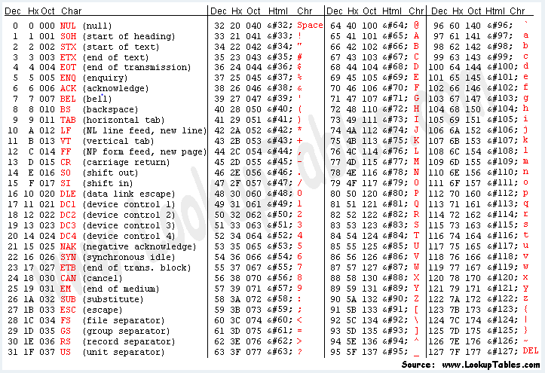
Base64 and ASCII
-Computer only stores / knows binary.
-Different binary numbers represent letters, and computer -interprets them and displays these numbers on screen – ASCII.
-Ex. 65 is A. Binary 65 is 01000001.
We use hex to represent binary numbers because they are easier to read than binary. So hex A = 41.
(decimal) Base 10: 123 = 1 * 10^2 + 2 * 10^1 + 3 * 10^0 = 123
(hex) Base 16: 123 = 1 * 16^2 + 2 * 16^1 + 3 * 16^0 = 183
Another common base is 64.
Base 64: 123 = 1 * 64^2 + 2 * 64 ^ 1 + 3 * 64 ^ 0 = 220599
Base 64 is easily identified by the fact that it has
both capital and lower case letters
numbers
may end with ==.
Ex. SGVsbG8gdGhlcmUgaG93IGlzIGl0IGdvaW5nPw==

Slide 8
Crypto: 8th grade - Hashes
Usually used to verify contents of a file/message.
Take parts of the message, create a fixed length string of text from it that doesn’t reveal the text.
Famous Hashing algorithms:
MD5
SHA-#
Can be reverse engineered/brute forced if message is short
Collision based attacks as well.

Slide 9
Live Problems! Level 1
Caesar:
Pn3fne P1cU3e gb0 rM
Substitution:
gag wdv lfdt cepc 'i' ar cei odrc vrig niccik af cei ifmnare pnxephic? wdv qpf qkpql rvhrcacvcadf qaxeikr xkiccw ipranw tace ukijvifqw pfpnwrir!
Base64 -> ASCII:
RXZpbCBDb3JwLCB3ZSBoYXZlIGRlbGl2ZXJlZCBvbiBvdXIgcHJvbWlzZSBhcyBleHBlY3RlZC4g\nVGhlIHBlb3BsZSBvZiB0aGUgd29ybGQgd2hvIGhhdmUgYmVlbiBlbnNsYXZlZCBieSB5b3UgaGF2\nZSBiZWVuIGZyZWVkLiBZb3VyIGZpbmFuY2lhbCBkYXRhIGhhcyBiZWVuIGRlc3Ryb3llZC4gQW55\nIGF0dGVtcHRzIHRvIHNhbHZhZ2UgaXQgd2lsbCBiZSB1dHRlcmx5IGZ1dGlsZS4gRmFjZSBpdDog\neW91IGhhdmUgYmVlbiBvd25lZC4gV2UgYXQgZnNvY2lldHkgd2lsbCBzbWlsZSBhcyB3ZSB3YXRj\naCB5b3UgYW5kIHlvdXIgZGFyayBzb3VscyBkaWUuIFRoYXQgbWVhbnMgYW55IG1vbmV5IHlvdSBv\nd2UgdGhlc2UgcGlncyBoYXMgYmVlbiBmb3JnaXZlbiBieSB1cywgeW91ciBmcmllbmRzIGF0IGZz\nb2NpZXR5LiBUaGUgbWFya2V0J3Mgb3BlbmluZyBiZWxsIHRoaXMgbW9ybmluZyB3aWxsIGJlIHRo\nZSBmaW5hbCBkZWF0aCBrbmVsbCBvZiBFdmlsIENvcnAuIFdlIGhvcGUgYXMgYSBuZXcgc29jaWV0\neSByaXNlcyBmcm9tIHRoZSBhc2hlcyB0aGF0IHlvdSB3aWxsIGZvcmdlIGEgYmV0dGVyIHdvcmxk\nLiBBIHdvcmxkIHRoYXQgdmFsdWVzIHRoZSBmcmVlIHBlb3BsZSwgYSB3b3JsZCB3aGVyZSBncmVl\nZCBpcyBub3QgZW5jb3VyYWdlZCwgYSB3b3JsZCB0aGF0IGJlbG9uZ3MgdG8gdXMgYWdhaW4sIGEg\nd29ybGQgY2hhbmdlZCBmb3JldmVyLiBBbmQgd2hpbGUgeW91IGRvIHRoYXQsIHJlbWVtYmVyIHRv\nIHJlcGVhdCB0aGVzZSB3b3JkczogImZsYWd7V2UgYXJlIGZzb2NpZXR5LCB3ZSBhcmUgZmluYWxs\neSBmcmVlLCB3ZSBhcmUgZmluYWxseSBhd2FrZSF9Ig==.

Slide 10
Your turn:
Check out www.github.com/sidsenkumar11
Fun fact – these were 3 of the 100 point problems from CSAW this past weekend!
General Tips:
Don’t try to re-invent the wheel. For most ciphers and conversions you can think of, someone has already implemented a converter. Use them – your own implementations are more likely to a) take time and b) be error prone.
Read up on things you don’t understand! A google search on most of these topics will get you thousands of results and webpages.
Ask questions if you don’t help. That’s why we’re here.

Slide 11
Crypto: Level 3
RSA
Public Key Cryptography
OTP with repeated key use
http://travisdazell.blogspot.com/2012/11/many-time-pad-attack-crib-drag.html
https://github.com/SpiderLabs/cribdrag

